Slide 1
HOMES FOR
EVERY WOMEN
A Sangeeta Ahir Initiative

Slide 2
WOMEN
I NVESTING IN
SUSTAINABLE
HOMES

Slide 3
AGENDA
WISH TEAM
HIERARCHY
ABOUT WISH
VISION, MISSION & PURPOSE
GLOBAL PRESENCE
WISH CITY
CHALLENGES
SOLUTIONS
BENEFITS OF WISH
FACILITIES
SURVEY
PROJECT & TICKET SIZE
ACTION PLAN

Slide 4
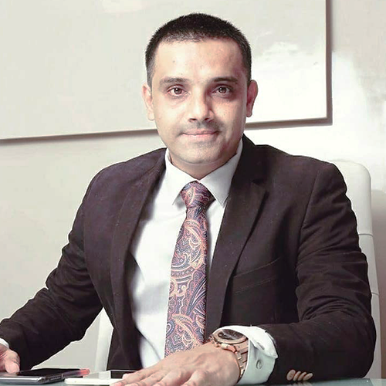
Wish Team
Sangeeta Ahir (Founder & Chairperson)
This Project is Founded by Sangeeta Ahir and is also a brand ambassador of Hera India under which WISH is a Women housing project Initiated in India for empowering the Women of India. She is successfully running multiple NGOs in the name of Shree Sankalp Pratisthan and Maitree which promotes free healthcare services, Education, Women Safety, Training, Job Creation for underprivileged in Urban & Rural Areas etc.
Sameer Virani (Co-Founder & Director)
With 17 years of Rich Expertise in Global Real estate he is involved in End to End Execution of WISH Project taking care of Planning, Strategy, Advisory, Sales / Marketing, Acquisitions, Fund Raising & Management

Slide 5
Hierarchy
Founder & Chairperson
Bank / NBFC Funds
CSR Fund
Co- Founder & Director
Sales &
Marketing
Architect
Liasoning
Legal Advisor
Public Relations

Slide 6
WISH (A REAL ESTATE NGO)
WISH is a Real estate NGO who is working towards building affordable women housing projects pan India with a vision of providing homes for all women by 2025
WISH Inspired by Hera is a Subsidized Women housing project for the women who couldn’t gather courage to buy her dream home
The first WISH program started in Mumbai, India as a pilot project for Women housing
WISH allows women to support other women to get their own home
WISH can be replicated anywhere in the world Subject to defined terms
WISH programs are in development

Slide 7
Vision
Empowering Women by providing pool of affordable apartment with secure neighborhood and secure housing
Mission
To provide housing for all women in INDIA by 2025
Purpose
To serve the humanity

Slide 8
Changing the Mindset
Generally in any Indian family when there is a son and a daughter. While buying a property first preference is always given to son and it is always bought on sons name. We at WISH want to change this Mindset of the society and practice gender equality and set a case study for future young generations to come

Slide 9
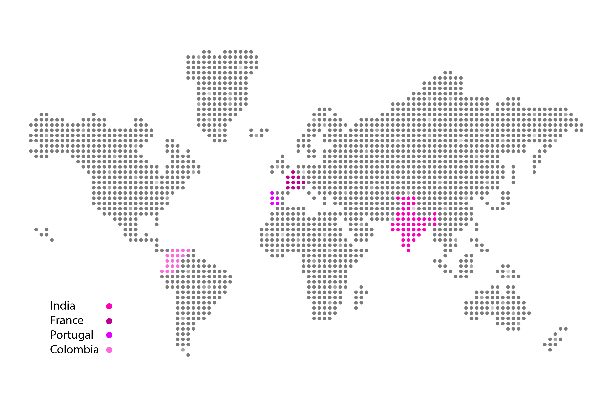
Global Presence

Slide 10
Wish City
India’s first digital city exclusively for women
The first WISH program started in Mumbai, India as a pilot project for housing.
This way WISH allows women to support
other women to get their own home
WISH can be replicated anywhere in
the world.
Other WISH programs are in
development

Slide 11
CHALLENGES
Unavailability of flexible payment options
Unavailability of housing finance due to lower eligibility.
Higher rate of interest
Insecurity of future due to lack of support from family members / husband etc
Higher valuation of the properties
This project is for Women, who didn’t gather courage to buy home
for herself due to :

Slide 12
SOLUTIONS
Low Cost Affordable Homes
Secured environment for women
At WISH we will facilitate promote, educate, and elevate women promoting the sustainability of human development around the globe.
A platform that unifies and magnifies the voices and work of extraordinary women, setting an example and standard for the future generations
Female mentorship program and education. When women register for WISH platform they are connected to women around the world and able to communicate and share experiences.

Slide 13
BENEFITS OF WISH
Possible Exemption on stamp duty & registration ?
Lower monthly maintenance
Lower interest rate on housing finance in compare
to the market
5 year Health and life insurance benefit for the
family along with the house
Scholarship for the kids of single mother opting
for higher education subject to merit / eligibility
Flexible payment options with possibility of
10 : 90 Scheme

Slide 14
Project Highlights
Social Infrastructure
School, Hospitals, Banks, Atm, Supermarket
Amenities
Club house, Yoga and meditation center, Senior citizen sit outs, Children's play area, Outdoor Sports facilities, Power back up for common Areas
Safety and Security
Video door phones, Panic Switch, 24/7 App
Based Security, 24/7 Women Help desk

Slide 15
Free Interior Designing consultation
In house school & hospitals
Free legal consultation
Panic switch to be provided in all apartments in case
of emergency
Doctor on call
Quarterly medical check ups for family at a reasonable fee
24/7 App based security services on one click
Shuttle services for pick up and drop to the nearest station / market every hour
Affordable Co-working spaces for women entrepreneurs
Access to women rights organizations

Slide 16
Women Home Buyer Survey Highlights
The share of single women buyers in India, is 9%.
28% women prefer mortgage over marriage, against 22% men
62% women are ready to sell their jewelry for property
70% women prefer real estate as their first investment, as compared to 58% men.
Single women are willing to spend up to 60% of their income on property, against 38% for men.
74% of the women are involved in decision of home buying.

Slide 17
Women Home Buyer Survey Highlights
The top three cities with single women buyers are
Ahmedabad (14%), Kolkata (12%) and Bengaluru (11%).
13% of married women are major contributors in the Home buying process.
84% feel that developers do not understand the needs of women buyers.
92% women buyers said that they would like to see women staff
78% single women buyers say they have faced discrimination in their neighborhood

Slide 18
Project & Ticket Size
Project Size | Ticket Size
Approximate carpet for 1 BHK 375 - 425 Sq. ft | Approximate 45 to 60 Lacs All Inclusive
Approximate carpet for 2 BHK 550 - 700 Sq. ft | Approximate 65 to 90 Lacs All Inclusive
Approximate carpet for 3 BHK 775 - 900 Sq. ft | Approximate 1 cr to 1.50 cr All Inclusive

Slide 19
ACTION
PLAN
To identify and acquire land parcel in & around Mumbai, Indore & Goa with the right feasibility to pass on maximum benefits to WISH project buyers
To Identify the developers who would partner with WISH on a Joint Venture basis in this noble cause
To raise funds from global NGO’s, Banks, NBFC,S to support this cause and make it a success

Slide 20
“It took me quite a long time to develop a voice,
And now that I have it, I am not going to be silent.”
- Madeleine Albright

